Slide 1


AI FINANCIAL
ADVISOR
Software Engineering Department
24-2-D-26
Submitted by
Supervisor
Chay Fadida
Tomer Lazarovitch
Alexander Keselman

Slide 2

Software Engineering Department
Introduction
In today's financial landscape, the stock market remains a lucrative but complex arena for investment, particularly for individuals without financial expertise.
The primary challenge for these individuals is the high cost and often inaccessible nature of professional financial advice, coupled with the overwhelming array of investment choices.
Our project seeks to address these barriers by developing an innovative web application that combines artificial intelligence with advanced analytics to offer personalized stock investment advice.

Slide 3

Current
Options
Today’s market primarily consists of several key options for individuals looking to learn and menage their finance and investments:
01
02
Various independent financial websites.
Investment courses.
03
04
Resources for self learning.
Bank-affiliated financial advisor.

Slide 4

Problem 01
High fees or minimum investment thresholds, limiting accessibility for average investors.
Problems
Problem 02
Potential bias in advice, as advisors may be restricted to offering products from their respective banks.
Problem 03
Lack of personalization, leading to less optimized investment strategies.
Problem 04
Require significant time and effort to fully grasp complex financial concepts.
Problem 05
Steep learning curve, making it difficult for beginners to apply knowledge in real-time market conditions without guidance.

Slide 5

Our Solution
Introduction of our AI-powered platform
Our AI-driven financial advisory platform is designed to offer personalized investment advice, making the complexities of stock market investing more accessible to users of all financial knowledge levels.
By leveraging advanced AI algorithms, the platform can provide tailored recommendations that align with users’ financial goals, risk tolerance, and preferences.
This ensures that even users without extensive financial expertise can make informed decisions with confidence.

Slide 6



Real-Time Data Analysis
Features
By integrating real-time financial data from trusted sources, our platform provides up-to-the-minute stock analysis and market trends.
Personalized Recommendations
Interactive Chatbot
The platform uses AI algorithms to analyze user financial data, investment history, and market trends to deliver highly customized stock recommendations.
The platform features a user-friendly chatbot powered by advanced AI models. This chatbot can engage users in natural language conversations, answering questions, providing advice, and helping users navigate their investment options.

Slide 7

Simplify investment decisions for all users
Our Goals
Our platform aims to make investing accessible to users at all levels of financial expertise. Whether a beginner who is just starting out or an experienced investor looking for advanced insights.
Provide AI-driven personalized stock recommendations
By analyzing individual user profiles, financial goals, risk tolerance, and current market trends, the AI system can offer tailored investment advice that fits each user’s unique needs.
Use real-time data to enhance decision-making
Accurate and timely information is critical for making sound investment decisions. Our platform integrates real-time stock data, financial news, and market trends to ensure that users have access to the most up-to-date information.
Offer a user-friendly interface for ease of use
The platform is designed with simplicity and ease of use in mind. A clean, intuitive interface ensures that users can navigate the platform effortlessly, whether they are reviewing stock recommendations, tracking their portfolio, or interacting with the AI chatbot.

Slide 8

Research Approach
Extensive research focused on meeting market demands and addressing user needs.
Analysis of traditional services, robo-advisors, and AI-powered platforms to identify key trends and gaps.
Surveys and interviews revealed a strong demand for easy-to-understand, personalized financial advice.
Users expressed frustration with the lack of affordable solutions in the market.
The feedback shaped the development of a user-friendly platform offering flexible investment strategies with real-time, accurate data to build user trust.

Slide 9
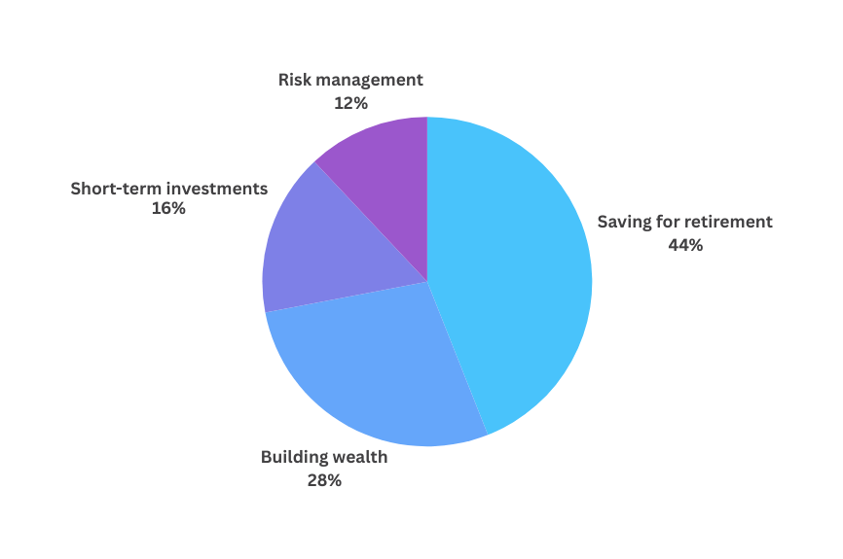
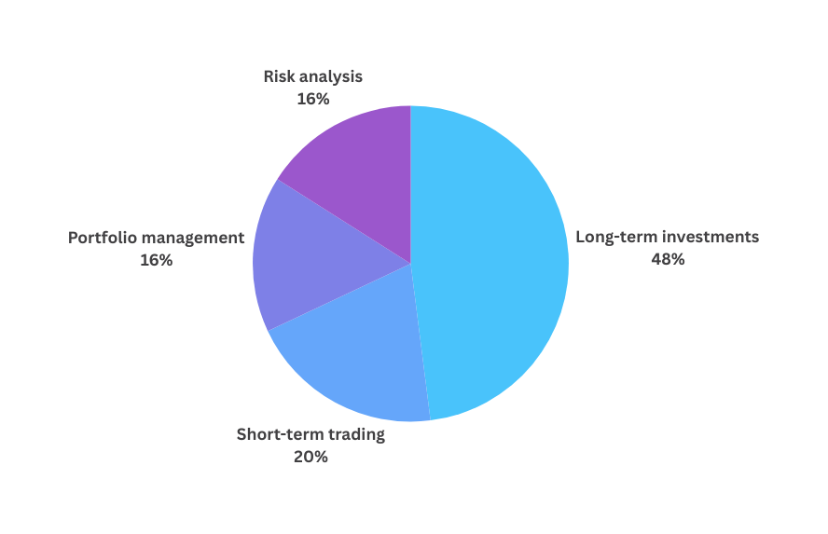
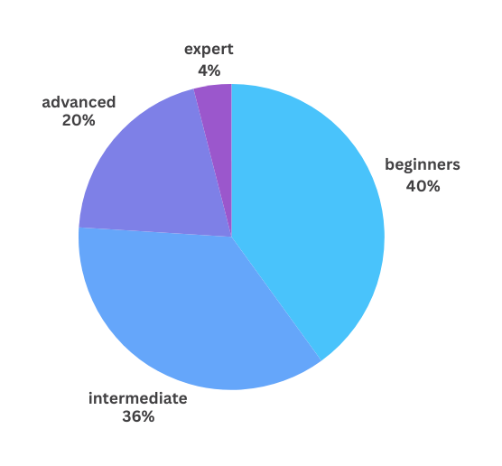
Survey Results and Insights
What is your level of investment knowledge?
What are your primary financial goals?
What type of financial advice are you looking for?

Slide 10
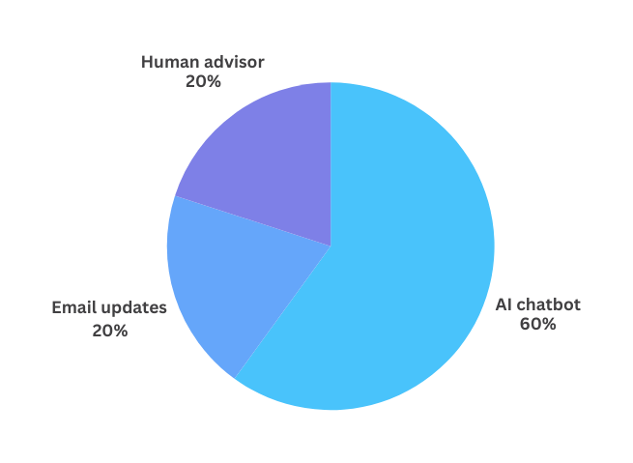
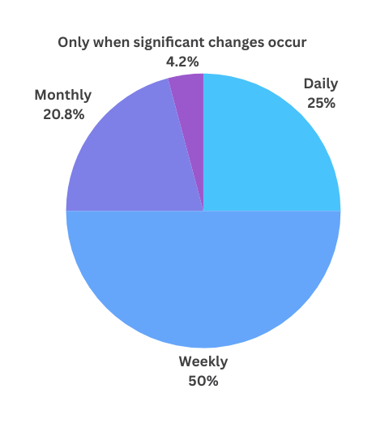
Survey Results and Insights
What is your preferred interaction method for financial advice?
How frequently would you want to receive updates on your portfolio?

Slide 11

01
Survey Results and Insights
Persona 1: Gili, The Young early-career individual
• Age: 26
• Occupation: Marketing Manager
• Income: $75,000 per year
• Investment Experience: Beginner (Less than 1 year)
• Financial Goals: Building wealth and saving for a home
• Risk Tolerance: Moderate
Needs:
• Simple, easy-to-understand investment advice.
• A user-friendly platform for learning basics.
• Long-term investment recommendations
Interaction with the Platform:
Gili will use the AI chatbot to ask questions about stock performance and get safe investment recommendations. She values educational resources and the ability to customize her goals without feeling overwhelmed.
Personas

Slide 12

02
Survey Results and Insights
Persona 2: Israel, The Seasoned Investor
• Age: 45
• Occupation: IT Consultant
• Income: $150,000 per year
• Investment Experience: Advanced (10+ years)
• Financial Goals:Maximize return of investment
• Risk Tolerance: high
Needs:
• Advanced tools for real-time data analysis
• Customizable AI recommendations
• Insights into market trends and predictive analytics
Interaction with the Platform:
Israel will leverage real-time data tools and AI recommendations to supplement his research. He values the ability to customize advice to match his aggressive strategy and seeks predictive models for quick, high-return trades.
Personas

Slide 13

03
Survey Results and Insights
Persona 3: Sara, The Retiree
• Age: 62
• Occupation: Retired School Teacher
• Income: $50,000/year (pension and savings)
• Investment Experience: Intermediate (3-5 years)
• Financial Goals: Financial security
• Risk Tolerance: Low
Needs:
• Low-risk investment recommendations
• Clear explanations of investment performance
• Automated portfolio management with periodic updates
Interaction with the Platform:
Sara will use the platform’s automated portfolio management for safe, low-volatility investments. She prefers minimal interaction but appreciates regular, easy-to-understand updates via email. Security is her top priority, ensuring her investments are protected.
Personas

Slide 14


Integration Challenge
Challenges
Ensuring seamless integration with all micro services (Front-End, Back-End, DataBase and LLM model)
API Compatibility
Correct Use of AI Model
Maintaining compatibility with multiple APIs while ensuring system responsiveness and reliability.
Ensuring proper usage of AI models by designing effective prompts and maintaining prompt quality to achieve accurate financial advice.

Slide 15


01 Iterative Development Approach
Built and refined the platform incrementally based on user feedback.
02 Chatbot Prototype Development
Developed a simple chatbot prototype focused on natural language queries about stock investments.
Conducted early user testing to gather feedback and enhance usability.
Execution Plan
03 System Architecture Design
Chose ReactJS for a dynamic front-end interface and FastAPI for handling real-time requests on the back end.
Integrated external financial APIs for real-time data processing.
04 Data Storage Setup
Implemented MongoDB to manage unstructured financial data with scalability in mind.
05 AI integration
Incorporated CrewAI and large language models (LLMs) to process complex financial data and interact with users in natural language.

Slide 16

System Architecture
Back-End: FastAPI
High-performance Python framework for building APIs quickly and efficiently.
Supports asynchronous code for handling large data volumes and real-time user queries.
Provides automatic interactive API documentation via OpenAPI and JSON Schema, enhancing the development process.
Crucial for creating RESTful APIs that ensure seamless communication between frontend and backend.
Optimized for scalability and responsiveness, enabling the platform to handle increasing user demand and real-time financial analysis.
Streamlines integration of machine learning models and data flow, enhancing both user experience and backend performance.

Slide 17

System Architecture
Front-End: ReactJS
Popular JavaScript library for building interactive, user-friendly interfaces.
Supports component-based architecture, enabling reusable UI elements for efficient development.
Provides a responsive user experience with real-time updates and smooth navigation.
Ideal for creating a dynamic dashboard where users can track their investments and receive real-time financial insights.
Enhances user engagement with a clean, intuitive interface, making financial management straightforward for both beginners and experienced investors.

Slide 18

System Architecture
LLM Model (Large Language Model)
Advanced AI model designed to understand and generate human-like text for interpreting user queries and delivering conversational responses.
Supports Natural Language Understanding, allowing users to interact in everyday language without needing financial jargon expertise.
Provides Personalized Advice Generation by analyzing user inputs and financial data to deliver tailored investment recommendations.
Continuous Learning capabilities enable LLMs to adapt to new financial trends and user feedback, ensuring that advice remains relevant and accurate.
Facilitates Document Analysis and Integration, allowing users to upload financial documents, with the LLM extracting and incorporating relevant data into investment portfolios for real-time, comprehensive advice.

Slide 19

System Architecture
CrewAI
Framework for collaborative AI agents that specialize in different aspects of stock analysis.
Enables the creation of a “crew” of agents, each focused on specific tasks like gathering financial data, analyzing trends, and providing actionable insights.
Collaborative nature ensures seamless teamwork between agents, offering a comprehensive view of financial data and stock performance.
Enhances the investment advisor’s ability to deliver well-rounded analysis and suggest informed investment strategies.
Allows for multifaceted financial analysis, considering various financial factors for more accurate and holistic advice.

Slide 20






System Architecture
Final Architecture
Stock API
LLM Model
Web Browser
CrewAI
AI Financial Advisor
ReactJS
Fast API
MongoDB

Slide 21
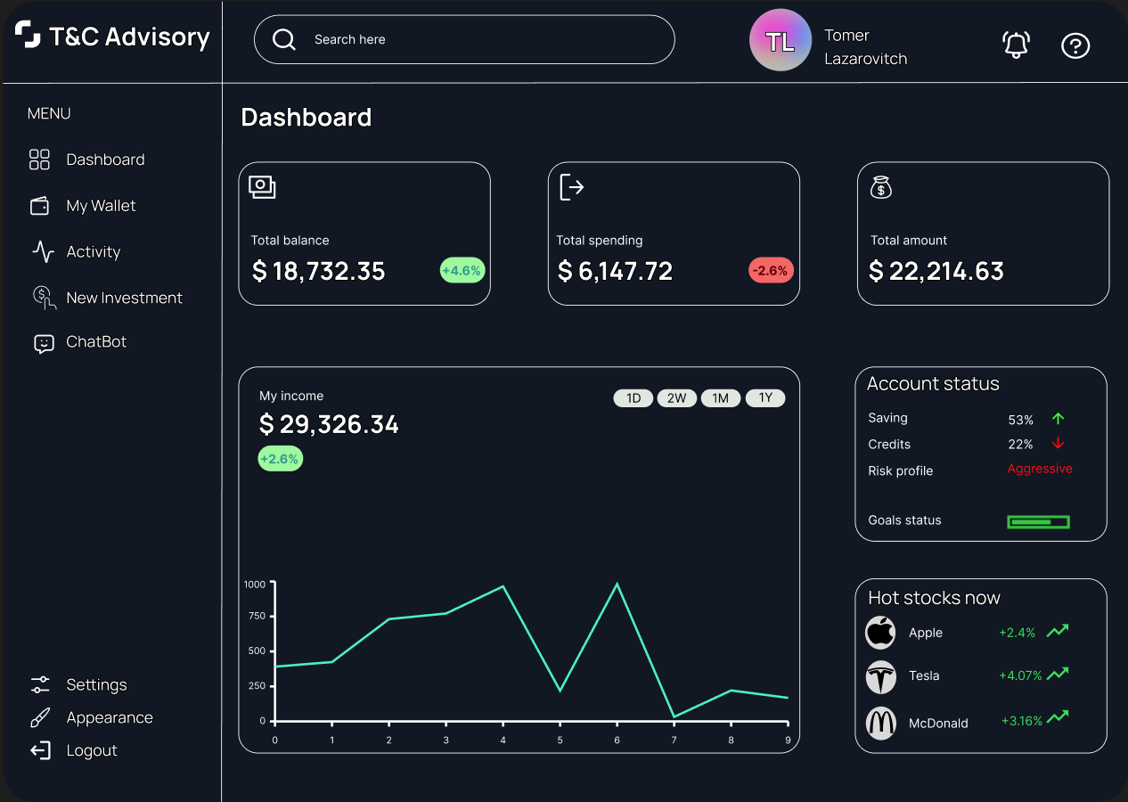
User Interface Design

Slide 22
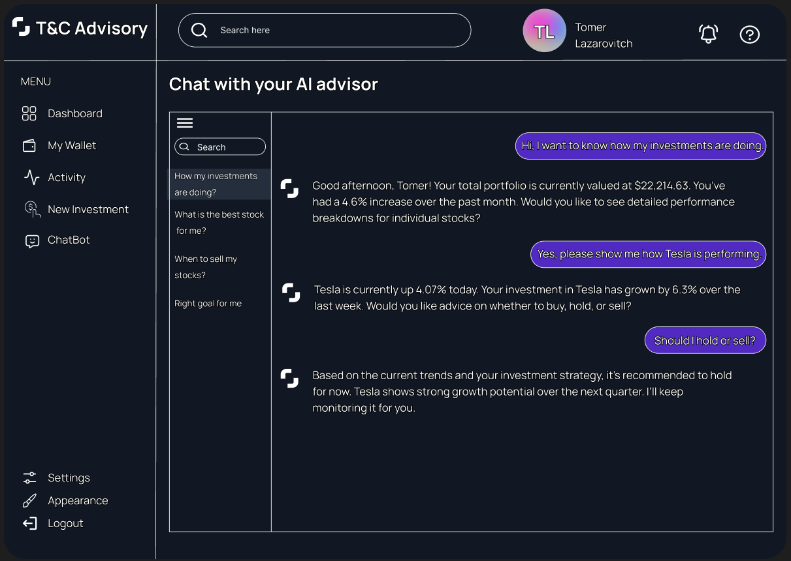
User Interface Design

Slide 23
User Interface Design

Slide 24

Product Testing Plan
Back-End Verification
Unit Testing: We will use Pytest to test individual components, such as functions and classes, to ensure they perform as expected.
API Testing: FastAPI’s TestClient and HTTPX will be used to simulate HTTP requests and verify that all API endpoints function correctly.
Performance Testing: Ensures the back-end can handle multiple requests efficiently, maintaining optimal performance under load.

Slide 25

Product Testing Plan
Front-End Verification
Unit Testing: Jest will be used to test individual React components, ensuring they render and function as intended.
Component Interaction Testing: React Testing Library will simulate user interactions, such as clicking buttons, to ensure components behave correctly.
Snapshot Testing: Ensures the UI remains consistent when updates or changes are made to the codebase.
End-to-End Testing: Cypress will be used for full application flow testing, ensuring seamless interaction between the front end and the back end.

Slide 26


